Slide 1
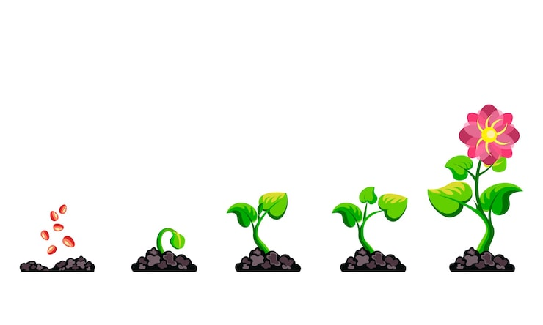
Our Plant
Photo Gallery
A Journey of Growth and Discovery 🌱
Grade 2 Science Project

Slide 2
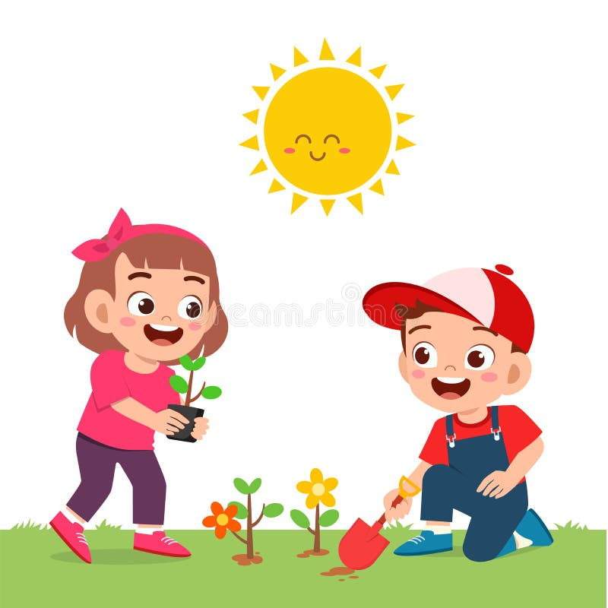
Do You Have Plants at Home?
Hello, little gardeners! 🌻
Do you have plants at your home? Maybe in your garden, on your balcony, or inside your house?
Have you seen how they grow?
Sunlight
Water
Care

Slide 3
How Do Plants Grow?
1
2
3
Plant Seeds
Small Stems
Big Plant!
We put tiny seeds in the soil
Small stems and leaves appear
It grows into a beautiful plant
It's like magic! But it's nature! 🌿✨

Slide 4
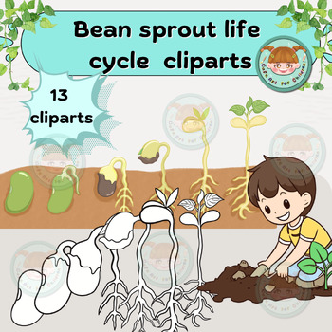
Meet Our Class Plant!
Correct! Look at this sapling that I've brought today! 🌱
This will be our class plant .
Everyone will help take care of it!
Water It
Take Photos

Slide 5
Our Weekly Mission
We'll water it and take a picture of it every week! 📸💧
Water
Photo
Every week, we will give our plant water to drink.
We will take a picture to see how it changes.
Plants need water to grow strong!
We can watch it grow into a plant!
So exciting! Let's begin! 🌟

Slide 6
W1
The Beginning
Week 1
What Do We See?
A small green stem
Tiny baby leaves
It's in a small pot
Our tiny sapling! 🌱
Let's take good care of it!

Slide 7
W2
Growing Bigger
Week 2
Week 1
Week 2
Small and tiny
Bigger now!
The Changes
Taller stem
More leaves
Looks happy!

Slide 8
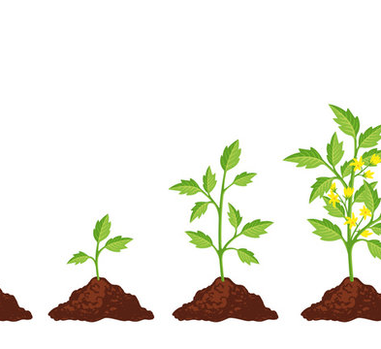
W3
More Leaves!
Week 3
Wow! Look!
Many new leaves!
Growing taller!
So healthy!
Great job, everyone!

Slide 9
W4
A Strong Plant!
Week 4
We did it! Our plant is big and strong! 🎉
W1
W2
W3
W4
Tiny
Bigger
More leaves
Strong!
Very tall!
Many leaves!
Beautiful!

Slide 10
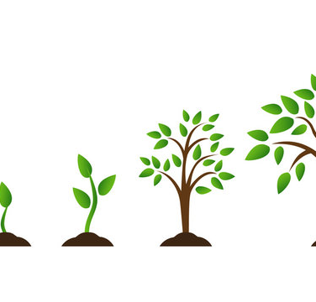
Make a Magic Video!
You can also put all the images together! 🎬
This way, you can make a video and animate it!
Watch the plant grow fast!
All Photos
Put Together
Watch!

Slide 11
What We Learned
Plants Need...
Plants Grow...
We Can...
Water
Slowly
Take photos
Sunlight
Over time
Watch growth
Care
Day by day
Make videos
You are all amazing scientists! 🌟

Slide 12
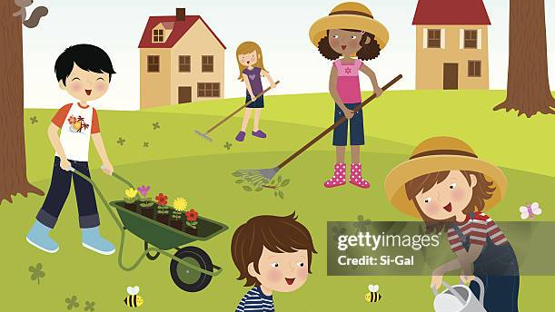
Great Job,
Little Gardeners!
You are all amazing plant caretakers! 🌱
Keep watching plants grow around you. Nature is full of wonders!
Keep Growing!
Keep Caring!

